Slide 1
Global Controller for Transient Stability and Voltage Regulation

Slide 2
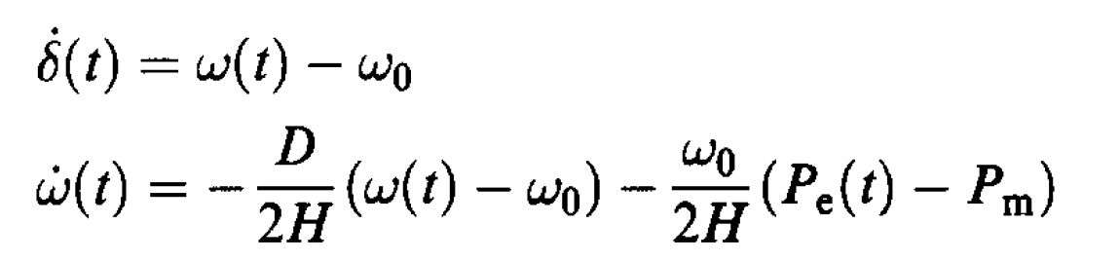
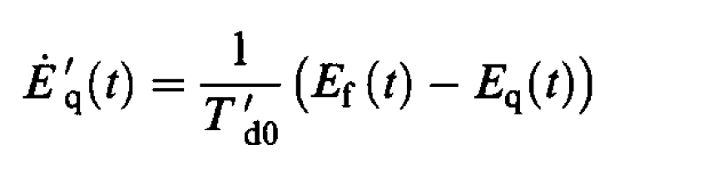
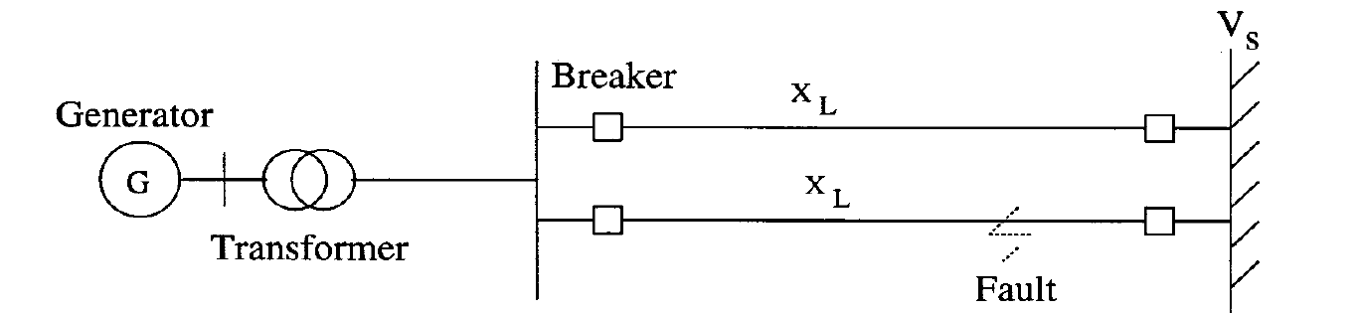
Single Machine Infinite Bus System (SMIB)

Slide 3
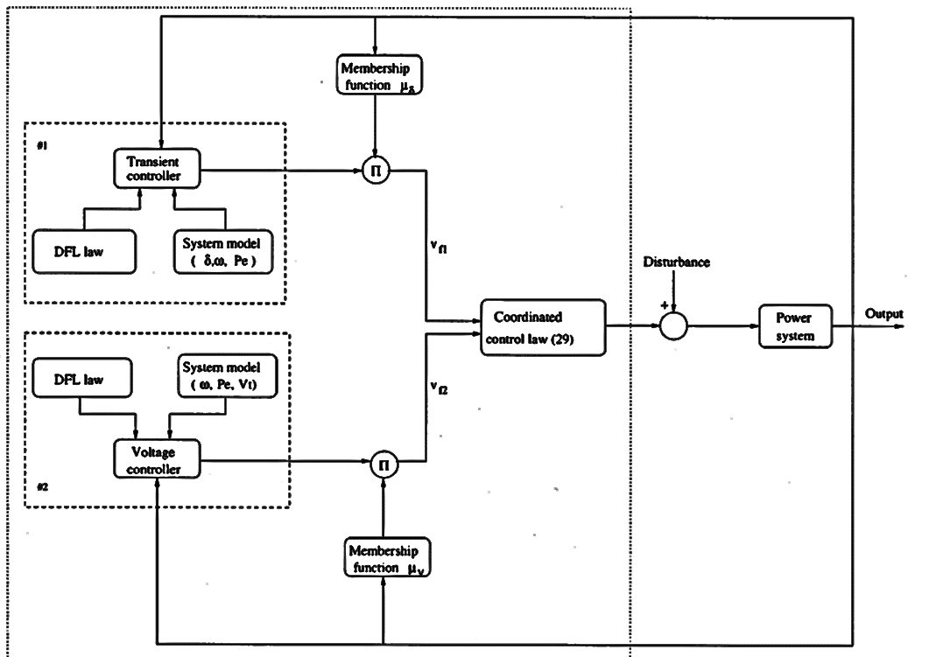

Slide 4
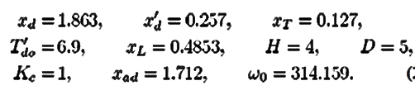
Initial_cond
(dict)
SMIB
(Super class)
Attributes:
Initial_cod,
Sys_parameters
Methods:
Init_variables
Sys_parameters
(dict)
Run_Simulation
Dynamics
(Sub class)
Attributes:
Step_time,
Transient Cont,
Voltage Cont,
Alphas,
Methods:
Mod_euler_solver,
Derivatives
Fault_reactance
Star_delta
Step_time, Transient Cont, Voltage Cont, Alphas, Fault times
Display_output
(Function)

Slide 5
Run_Simulation
1
Dynamics
(instantiate the class)
4*
5
2
Dynamics.mod_euler
Dynamics.fault_reactance
3
Dynamics.init_variables
Dynamics.derivative
outputs
For loop till end of sim. Time. Total reactance and controller type are changed with time.

Slide 6
